Slide 1

VAAGDEVI COLLEGE OF ENGINEERING
Project Title: ONLINE USERS PERFORMANCE THROUGN GRAPHICAL PATTERN
Team Members::
S.MANJUSRI(20641A6759)
B.MOUNIKA(20641A6704)
D.PRANAY KUMAR(20641A6723)
Y.SIDDHARTHA(20641A6766)

Slide 2
ABSTRACT :
Online shopping is growing on large scale. People purchase their products via internet. They just have to choose their products and make the payment. Users get their products on doorstep. Online shopping had made people’s life easier and faster. As online shopping is increasing, large amount of data on people’s online activities have become available on web. Use of such data can benefit a lot of applications. User behavior, online customer classification can be extracted from these web data. We proposed a system where we can extract the user’s online shopping behavior. System will extract user’s online behavior pattern and will show in graphical format. This graphical format helps the admin during decision making process. We propose a graphical hidden state model based on statistical features and integrate all available information sources to simulate the decision-making process. The proposed system, lead to nearly 30% of improvement on million click datasets. This system will be online web application where many products will be displayed on web page. User can view and purchase the products. User sequential behavior pattern is tracked by the system and is put in graphical format which helps during decision making process. This system helps the admin to know most frequently purchased products by the customer. Admin will also get to know which products are in demand. So he can make the decision based on the online behavior pattern of the customer. As user behavior pattern is put up in graphical format it will be easier for the admin to view the data and can make decision process faster and can come up with solution quicker.

Slide 3
INTRODUCTION :
The main purpose of this project is to analyze the behavior of users based on their activity on web while purchasing products. Here system can extract the user’s online shopping behavior and also extract user’s online behavior pattern and will show in graphical format. This graphical format helps the admin during decision making process.
What is Data Mining?
Generally, data mining (sometimes called data or knowledge discovery) is the process of analyzing data from different perspectives and summarizing it into useful information - information that can be used to increase revenue, cuts costs, or both. Data mining software is one of a number of analytical tools for analyzing data. It allows users to analyze data from many different dimensions or angles, categorize it, and summarize the relationships identified. Technically, data mining is the process of finding correlations or patterns among dozens of fields in large relational databases

Slide 4
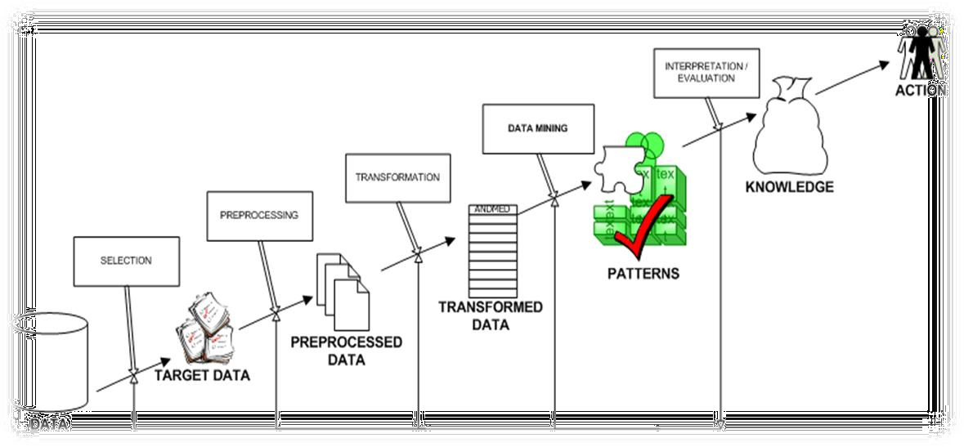

Slide 5
How Data Mining Works?
While large-scale information technology has been evolving separate transaction and analytical systems, data mining provides the link between the two. Data mining software analyzes relationships and patterns in stored transaction data based on open-ended user queries. Several types of analytical software are available: statistical, machine learning, and neural networks. Generally, any of four types of relationships are sought:
Classes: Stored data is used to locate data in predetermined groups. For example, a restaurant chain could mine customer purchase data to determine when customers visit and what they typically order. This information could be used to increase traffic by having daily specials.
Clusters: Data items are grouped according to logical relationships or consumer preferences. For example, data can be mined to identify market segments or consumer affinities.

Slide 6
Associations: Data can be mined to identify associations. The beer-diaper example is an example of associative mining.
Sequential patterns: Data is mined to anticipate behavior patterns and trends. For example, an outdoor equipment retailer could predict the likelihood of a backpack being purchased based on a consumer's purchase of sleeping bags and hiking shoes.
Advantages of Data Mining:
1. Marketing / Retail:
Data mining helps marketing companies build models based on historical data to predict who will respond to the new marketing campaigns such as direct mail, online marketing campaign…etc. Through the results, marketers will have appropriate approach to sell profitable products to targeted customers.
.

Slide 7
Data mining brings a lot of benefits to retail companies in the same way as marketing. Through market basket analysis, a store can have an appropriate production arrangement in a way that customers can buy frequent buying products together with pleasant. In addition, it also helps the retail companies offer certain discounts for particular products that will attract more customers.
2. Finance / Banking
Data mining gives financial institutions information about loan information and credit reporting. By building a model from historical customer’s data, the bank and financial institution can determine good and bad loans. In addition, data mining helps banks detect fraudulent credit card transactions to protect credit card’s owner.
3.Manufacturing
By applying data mining in operational engineering data, manufacturers can detect faulty equipments and determine optimal control parameters. For example semi-conductor manufacturers has a challenge that even the conditions of manufacturing environments at different wafer production plants are similar, the quality of wafer are lot the same and some for unknown reasons even has defects.

Slide 8
EXISTING SYSTEM
Coefficient of reliability is calculated at each step of classification. During classification a coefficient of reliability is changed. Based on this, normal or anomalous user behavior is identified. While classifying the user behavior the system monitors deviations between expected user behavior and current one. Coefficient of reliability is used to estimate the value of deviation in user behavior. If this value crosses a certain threshold, then it is considered as a case of abnormal behavior. That means the parameters in actions of user are not in admissible intervals. Coefficient of reliability is measuring the same individual twice and it correlates the 2 sets of measures. Every user action class was characterized by statistic parameters of time distribution – mean and standard deviation. Deviations from current values of sequential and temporal parameters are considered as consequence of abnormal behavior. The tools which are used to classify user behavior are N action classes and a relational matrix. These tools describe the model of user behavior.

Slide 9
DISADVANTAGES:
Users who don’t have internet connection can’t access the system.
System does not display products to the user which are purchased frequently.
PROPOSED SYSTEM
In this work, we propose to overcome the limitations of prior works in user preference modeling by exploring local and global user behavior patterns on a user successive behavior graph (SBG), which is constructed by utilizing short-term actions of all users. We then exploit high-order relations in the SBG to capture implicit collaborative patterns and preference signals with an efficient jumping graph convolution and learn enriched product representations for user preference modeling. Our approach addresses the aforementioned problems in the following two aspects

Slide 10
ADVANTAGES
This system helps to find out products which are more in demand.
This system provides the data in graphical format.
As user behavior pattern is put up in graphical format it will be easier for the admin to view the data and can make decision process faster and can come up with solution quicker
MODULES
ADMIN
USER

Slide 11
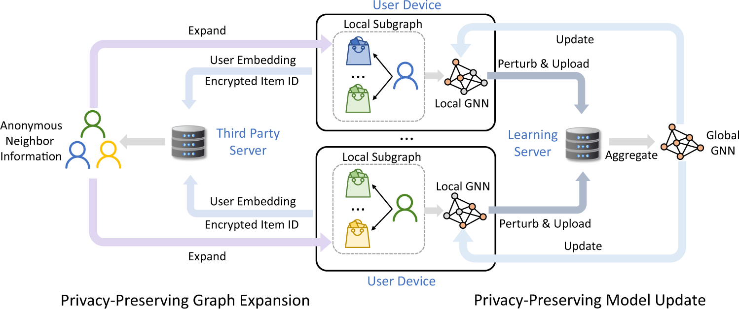
SYSTEM ARCHITECTURE

Slide 12
SYSTEM REQUIREMENTS
H/W SYSTEM CONFIGURATION
System : i3
Hard Disk : 40 GB.
Floppy Drive : 1.44 Mb.
Monitor : 15 VGA Color.
Mouse : Logitech.
Ram : 512 Mb.
SOFTWARE REQUIREMENTS
Technology : Java 2 Standard Edition, JDBC
Web Server : Tomcat 7.0
Client Side Technologies : HTML, CSS, JavaScript
Server Side Technologies : Servlets, JSP
Data Base Server : MySQL
Editor : Netbeans8.1

